Slide 1
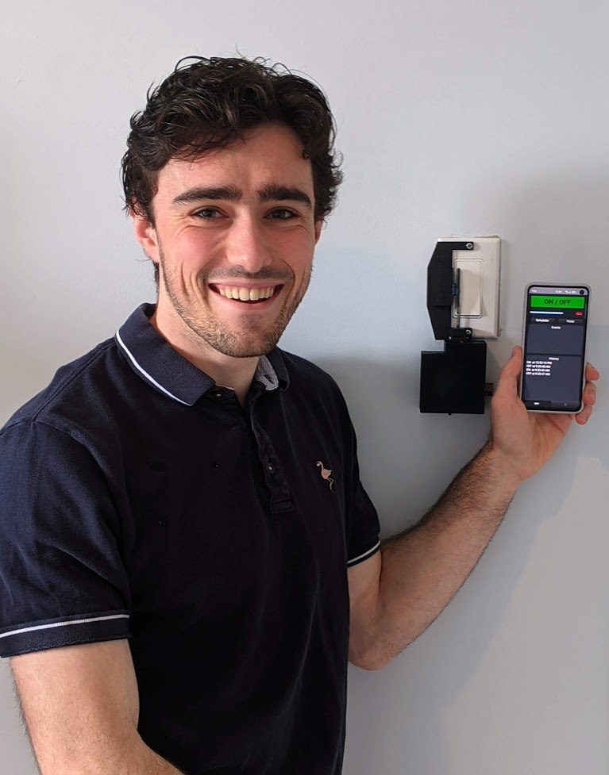
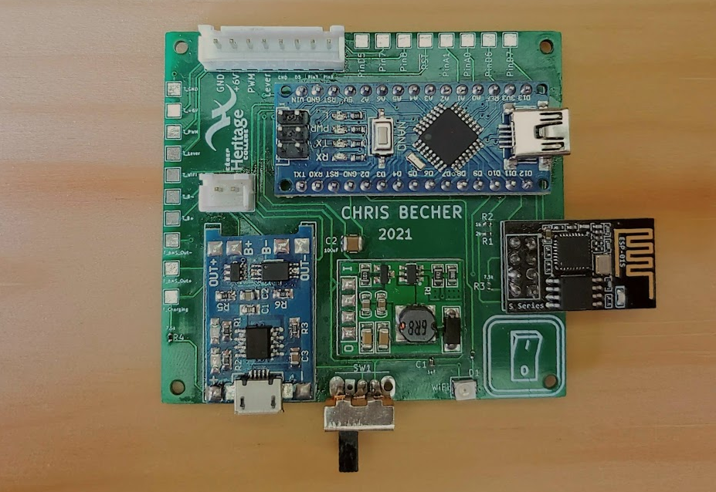
Project SWITCHY
A Switcher is an Arduino-based Internet-Of-Things device that controls a household light switch with a little servo motor. I used Embarcadero’s C++ Builder to build an Android application, which communicates with the Switcher using WiFi. It allows the user to toggle the light switch in real-time or in the future, and updates when the light is switched manually. The Switcher is lithium-ion battery powered and rechargeable.
Christopher
Becher
Motor Junction
Microcontroller
Battery Charger
WiFi Chip
Notes:
I made it so that if the printer crops the edges of the photos its ok, you don’t need to move the photos away from the edges of the page

